Slide 1
ProTracer
DATA 520 Project
Fall 2017
Mercyhurst University

Slide 2
Life’s Most Important Questions
Who?
What?
When?
Where?
Why?
How?

Slide 3
Who?
Who is responsible for this?

Slide 4

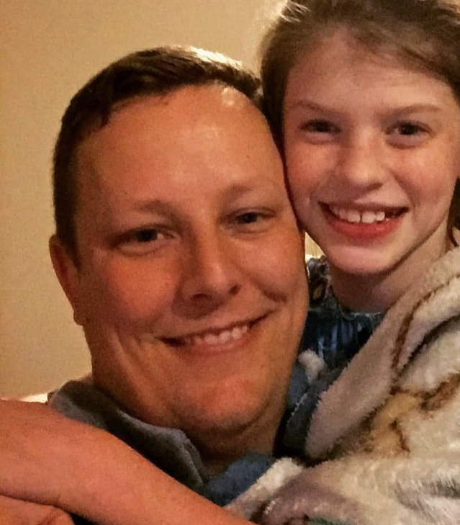

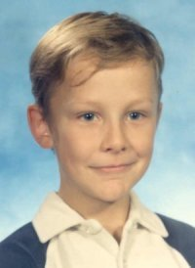

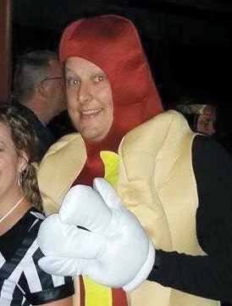


I did this

Slide 5
What?
What the heck is this crap?

Slide 6
What?
An application built with Python
To visualize golf shots from professional golfers
Using data from the PGA Tour’s Shotlink Intelligence System
In either 2D or 3D
For one or more shots at a time

Slide 7
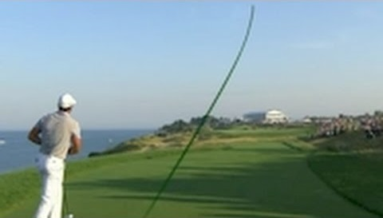
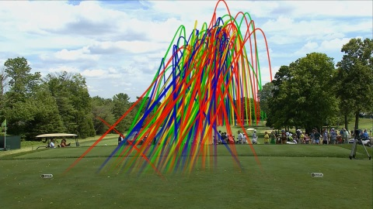
What?
Single Shot Example
Multiple Shot Example

Slide 8
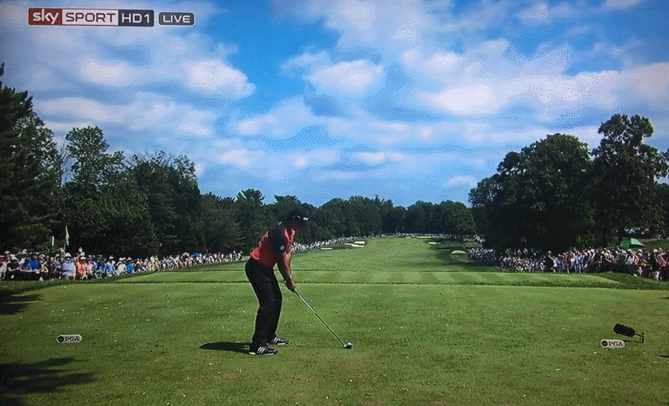
What?

Slide 9
When?
When was all this A+ worthy work completed?

Slide 10
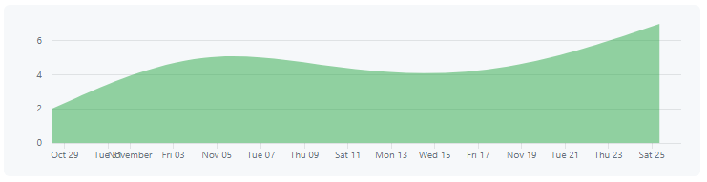
When?
GitHub Commit Logs
GitHub Activity
First commit: November 2, 2017
Last commit: December 5, 2017
25 commits

Slide 11
Where?
Where did the magic happen?

Slide 12
Where?
My house
Mercyhurst University
Panera Bread
Lake View Country Club
408 Bar & Grille

Slide 13
Why?
Why would anyone do this?

Slide 14

Why?
My Reasons
The Real Reason
I love golf
Looks cool on TV
Because I could
Fame
Fortune

Slide 15
How?
How could this have possibly happened?

Slide 16


How?
Alcohol
Head Scratching

Slide 17
How?
Python 3.6.1
Matplotlib 2.0.2
Numpy 1.13.3
Pandas 0.21.0
PyQt 5.6.2

Slide 18
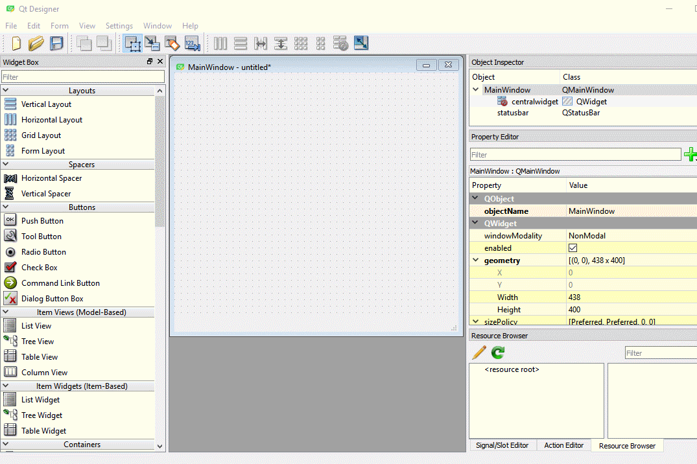
How?
QtDesigner
Comes bundled with Anaconda3
Drag and drop interface for building GUIs
Generates Python code similar to Tkinter

Slide 19
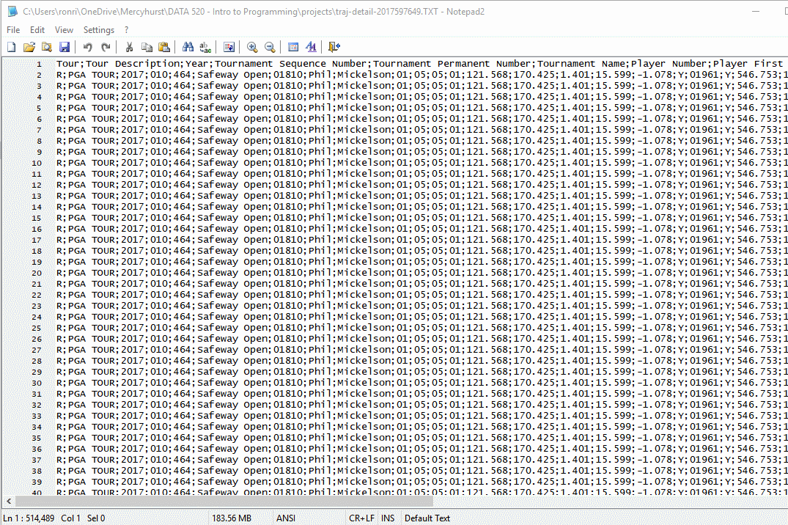
How?
PGA Tour ShotLink Intelligence System
Available for educational use in 2005
Contest in 2008 created new standard in golf statistics – Strokes Gained
Data export of trajectory data for 2017

Slide 20
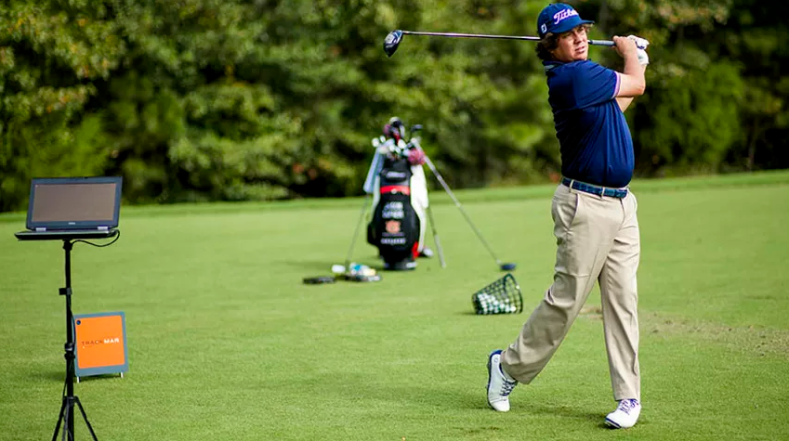
How?
Trackman uses doppler radar to capture the ball flight
Calculates club head speed and ball speed
Calculates carry distance, apex height
Device and camera are behind the golfer, facing towards the target
Between 30-50 data points for each shot
Some shots are extrapolated

Slide 21
How?
9 Python files
4 external Python modules
2 internal Python modules
3 data files
3 QtDesigner UI files
6 hard coded examples
7,595 total lines of code
459 lines of UI code from QtDesigner
201 lines of auto-generated Python code from QtDesigner
6,509 lines of auto-generated resource code (for images)
426 lines of hand-written code

Slide 22
How?
http://pyqt.sourceforge.net/Docs/PyQt5/index.html
https://pythonspot.com/en/pyqt5/
https://pythonspot.com/en/pyqt5-matplotlib/
https://stackoverflow.com/questions/43947318/plotting-matplotlib-figure-inside-qwidget-using-qt-designer-form-and-pyqt5
https://stackoverflow.com/questions/36222998/drawing-in-a-matplotlib-widget-in-qtdesigner
https://stackoverflow.com/questions/12459811/how-to-embed-matplotlib-in-pyqt-for-dummies
https://stackoverflow.com/questions/3972158/how-to-plot-on-my-gui
https://stackoverflow.com/questions/36665850/matplotlib-animation-inside-your-own-pyqt4-gui
https://stackoverflow.com/questions/4899176/qt4-mplot3d-of-matplotlib
https://stackoverflow.com/questions/29357442/example-of-embedding-matplotlib-in-pyqt5
https://stackoverflow.com/questions/42983449/python-getting-a-matplotlib-figure-to-rotate-when-embedded-in-a-gui
https://stackoverflow.com/questions/41167196/using-matplotlib-3d-axes-how-to-drag-two-axes-at-once
https://stackoverflow.com/questions/30330912/rotating-an-embedded-matplotlib-plot
http://matplotlib.org/examples/user_interfaces/embedding_in_qt5.html
https://www.mail-archive.com/matplotlib-users@lists.sourceforge.net/msg15322.html

Slide 23
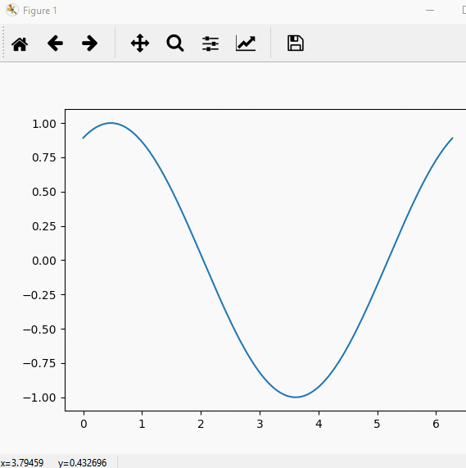
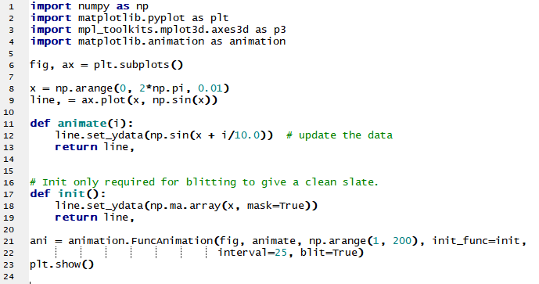
How?

Slide 24
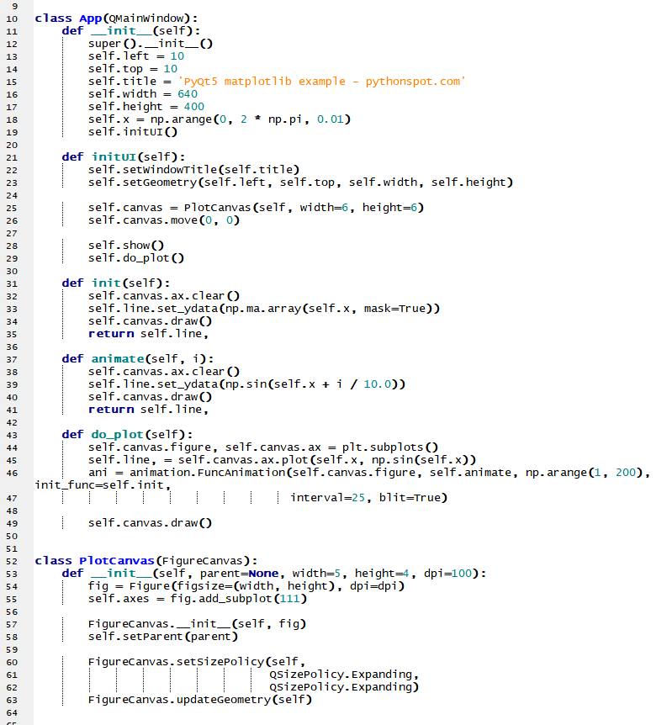
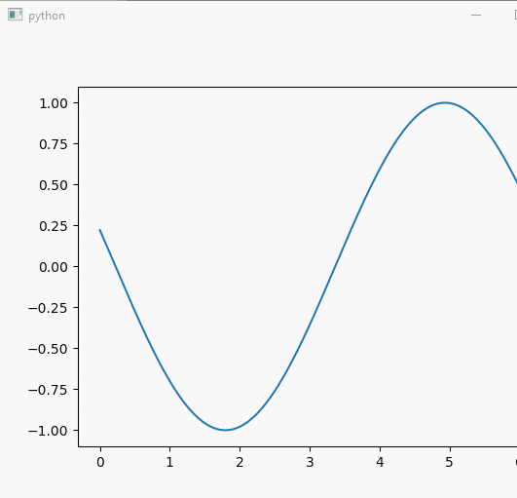
How?

Slide 25
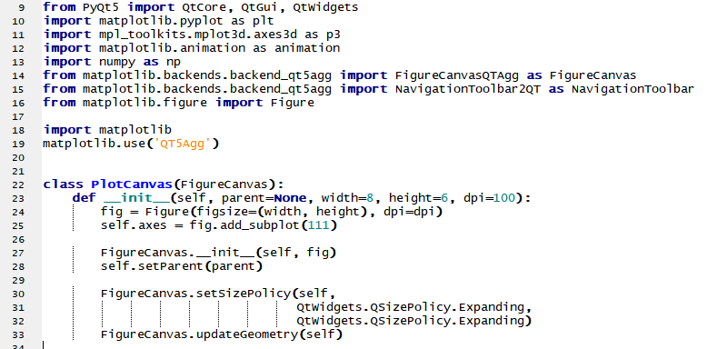
How?

Slide 26
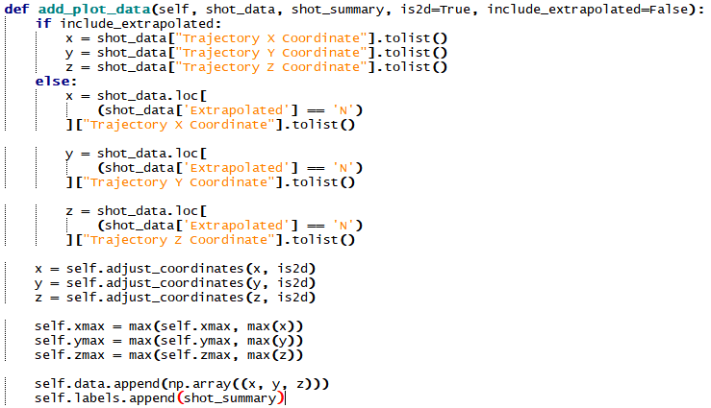
How?

Slide 27
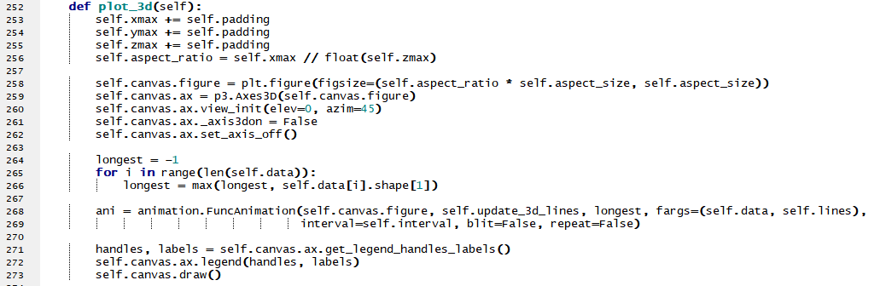
How?

Slide 28
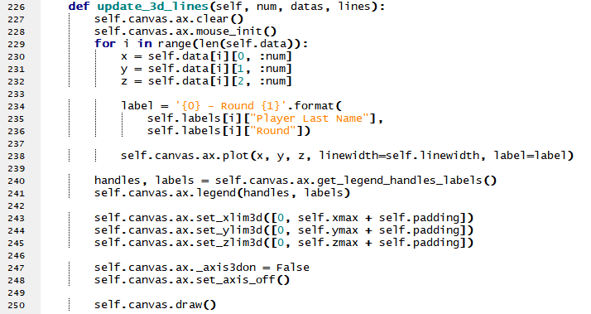
How?

Slide 29
Demonstration
I hope this works.

